Slide 1
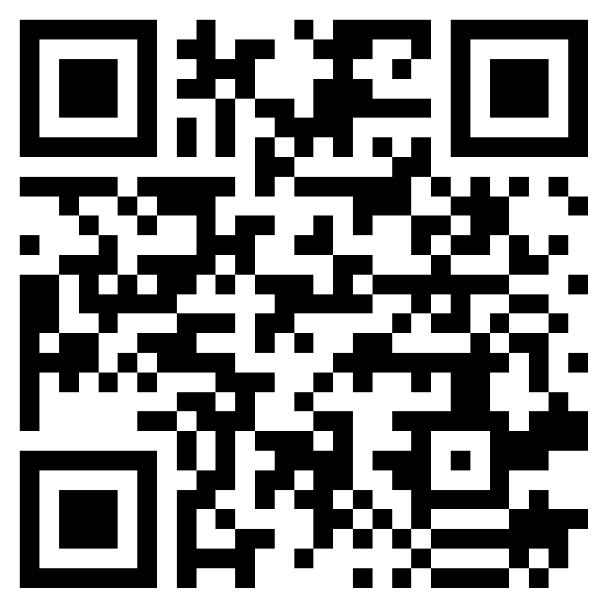
Scan the QR Code
After Scanning, Enter all requested information, the completed list will be posted in PASSPort
Contract Number: KENS-EAST-2

Slide 2
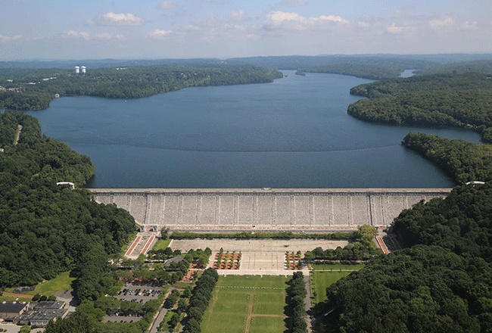
Contract KENS-EAST-2
Kensico Site Preparation
Valhalla, NY
Pre-Bid Meeting
July 12th, 2023
10:00 AM

Slide 3
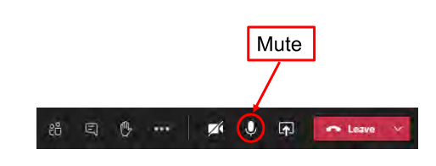
Virtual Meeting Guidelines
Please remain on mute
Do not put the call on hold
This session is being recorded

Slide 4
Agenda
Introductions
Safety Moment
Contract Administration
Project Background & Overview
Scope of Work
Work Restrictions
Schedule
Regulatory Requirements
Addendum #1
Environmental, Health & Safety Requirements
BEDC Enterprise PMIS
Questions
Nothing stated at the pre-bid conference or written on this agenda shall change the terms and/or conditions of the Invitation For Bid or Contract Documents unless a change is made by written amendment.

Slide 5
Introductions
Agency Contacts
  Ping Zhi Chan: pzchan@dep.nyc.gov
  Anna Zieba: azieba@dep.nyc.gov
BEDC PM
  Portfolio Manager: Lauren D’Attile, PE
  Deputy Portfolio Manager: Kevin Ellenwood
  Accountable Manager (Design): Justin Rivellino
  Accountable Manager (Construction): Vladimir Gomez
BEDC EHS
  BEDC EHS Regional Manager: Anne Ruzek – Edgar Lopez filling in
Engineer of Record
  Arup: Wylie Tsang & Haoran Zhang
  BEDC In-House Design: Sebastian Lopez (Civil), Jignesh Patel (Electrical), Clement Chan(Structural), and Howard Friedman(Architectural)
Construction Manager
  AECOM JV with Parsons: Leif Stepakoff & Don Lund

Slide 6

Safety Moment
TIPS TO BEAT THE HEAT

Slide 7
Contract Administration
KENS-EAST-2: Kensico Site Preparation

Slide 8

Bid Dates
Bid Package
  Pre-Bid Questions
    No later than July 26, 2023
    Submitted via “Discussion with Buyer” in
  Bid Security/ Bond Submission:
    Date: Thursday August 24, 2023
    Time: 10:00AM at 96-05 Horace Harding Expressway, 1st floor lobby
  Bid Submission
    Date: Thursday August 24, 2023
    Time: 10:00AM at 96-05 Horace Harding Expressway, 1st floor lobby
    AND in
Bid Opening
  Date: Thursday August 24, 2023
  Time: 2:00PM
  Via Teleconference: Microsoft Teams

Slide 9
PASSPort
All Bids/Proposals/Questions must be submitted in PASSPort
For assistance in using PASSPort contact the MOCS at:
  MOCS Service Desk

Slide 10
PASSPort Discussion Forum Tab
The Discussion with buyer tab is a forum to communicate directly in PASSPort with the RFx contracting agency after you have decided to respond to the RFx (i.e. clicked “Participate in RFx” button).
PASSPort maintains and can display a record of all interactions between you and the agency.
Indicate the Type of message you would like to send by selecting a category from the drop-down.
Add a Subject line.
Indicate the agency contact To whom you are sending this message by selecting from the drop-down menu.
Compose your message in the textbox.
Click the “Send” button to submit your message

Slide 11
PASSPort Helpful Links
PASSPort CBT Training
Vendor Enrollment Video
Vendor Account Management PDF
Contract Registration for Vendors
PASSPort User Materials - MOCS (nyc.gov)
E-Course Finding and Responding to RFx
User Manual Finding and Responding to RFx

Slide 12
State Revolving Loan Fund DBE Requirements
This Contract is subject to State Revolving Fund DBE Program.
The contractor agrees to make documented good faith efforts to utilize at least 20% of the total value of the contract to certified DBE’s
Prime contractor must utilize DBE suppliers/subcontractors that are certified on behalf of the United States DOT links to the various directories are located within the SRF Boiler Plate
Prime contractors certified as DBE as per the above can use their self-performance towards fulfilling the DBE participation goal
The awarded contractor will be required to submit Quarterly DBE reports and proof of payments to DBE’s throughout the term of the contract
The Contractor should also continue good faith efforts to seek opportunities for DBE participation during the life of the contract even if proposed fair share objectives have been achieved
After the bid opening the awarded contractor may contact the Office of Contract Compliance & Opportunities with any questions
Good Faith Efforts to subcontract work to DBEs will be required for all subcontractor approval requests of non-DBE subs

Slide 13
Project Labor Agreement
This contract is subject to a Project Labor Agreement
The successful bidder must be willing to assent to the terms of the PLA when requested prior to award of contract.
ALL prospective bidders are advised to read the Notice to Bidders and the PLA very carefully prior to submitting a bid on this project.
The local collective bargaining agreements referred to in the PLA as Schedule A collectively are available on a disk if requested by a prospective bidder from the ACCO.
The PLA will require the contractor and subcontractors to work exclusively or primarily with trade labor referred by the various local unions referenced in the PLA.
Any questions on the PLA may be submitted in writing in the same manner as other questions on the plans, specifications or other requirements of this bid.

Slide 14
Prevailing Wage
This contract is subject to prevailing wage requirements under the NYS Department of Labor Prevailing Wage Schedule for Westchester County
Workers must be paid the prevailing wage and supplement rates that are in effect (for each trade) at the time the work is performed in compliance with the Westchester County Prevailing Wage Schedule
Certified payroll report forms and DEP employee sign in sheets are required for all trade work performed under this contract.
The prevailing wage titles anticipated under this Contract include, but are not necessarily limited to: Electricians, Carpenters, Laborers, Masons, Painters, Plumbers, and Operators

Slide 15
Subcontractor Approval
A subcontractor cannot start work, even off site (e.g. fabrication of material) before the Subcontractor receives at least a Preliminary Approval
A contractor cannot get paid for a subcontractor’s work until the SAF receives final approval
A Request for a Subcontractor Approval Form (SAF) must be submitted for all subcontractors regardless of tier
An SAF is not needed for a supplier that strictly delivers equipment, goods or materials and leaves the project site after the delivery is made. For the purposes of ACCO subcontractor approval, a vendor is not considered a supplier if in addition to providing equipment, goods or materials, it also provides other services on or off site to the project including but not limited to installation, maintenance or consulting services
An SAF is required for every new subcontract and on contract renewals

Slide 16
Subcontractor Approval
Start date on the SAF must be left blank, the start date will coincide with ACCO approval
Time for approval varies widely
  We suggest SAF should be submitted at least 30 days before the subcontractor is needed on the project
It is important that the subcontractor on the SAF form is accurately identified as an M/W/DBE
If the subcontract amount changes (increases OR decreases) regardless of value, a revised (SAF) MUST be submitted
Good Faith Efforts to subcontract work to DBEs will be required for all subcontractor approval requests of non-DBE subs

Slide 17
Project Background & Overview
KENS-EAST-2: Kensico Site Preparation

Slide 18
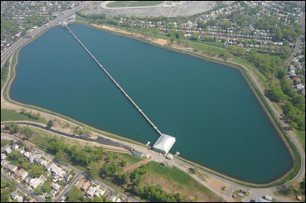
KEC Project Background
The Hillview Consent Decree is the agreement that the City of New York made for failing to comply with Safe Drinking Water Act Requirements that keep drinking water safe from harmful bacteria and viruses.
  On March 6th, 2006, the City became obligated to cover the Hillview Reservoir under the Safe Drinking Water Act. The regulation required that uncovered finished water storage facilities, such as the Hillview Reservoir, be covered or the discharge from the reservoir should be treated to achieve inactivation and removal of microbial contaminants by April 1st, 2009.
Hillview Consent Decree mandates that the City must complete two precursor projects prior to the construction of the Hillview Cover, which are the KEC Project & the Hillview Reservoir Improvements.
  During construction of the cover, the Hillview reservoir will need to operate with a single basin, which means that to ensure reliable water delivery, completion of both precursor projects is needed

Slide 19
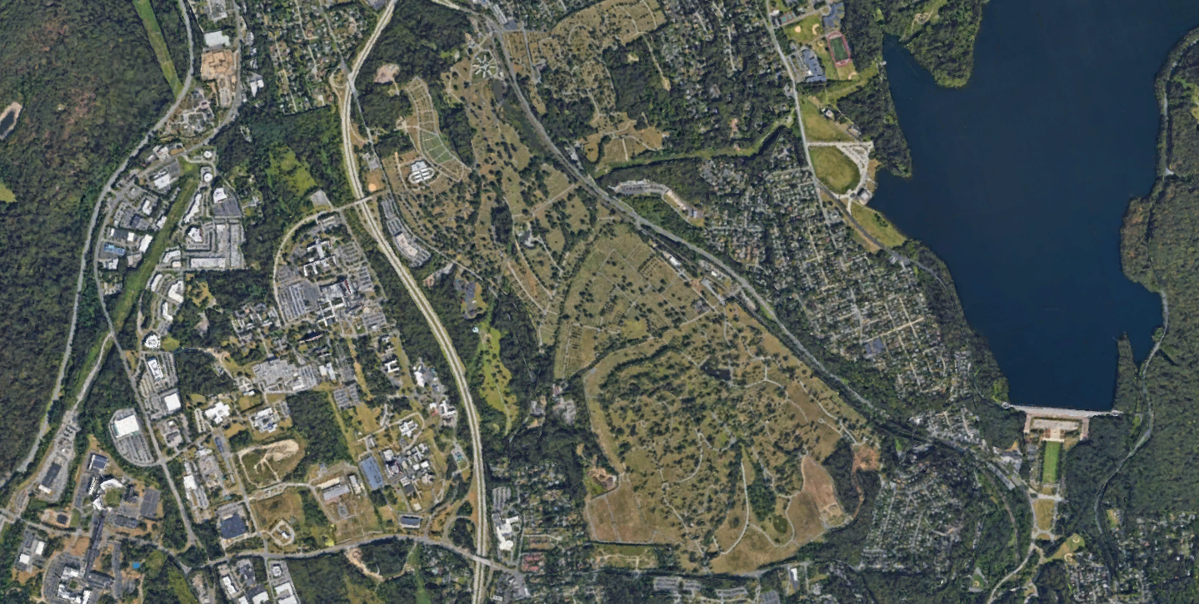

Project Overview
Existing Catskill Aqueduct
Kensico Site
New KEC Tunnel
Existing Delaware Aqueduct
Eastview Site

Slide 20
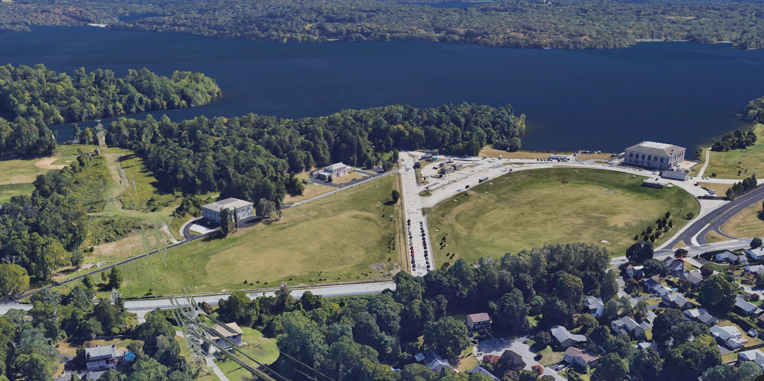
Project Overview: Site
P

Slide 21
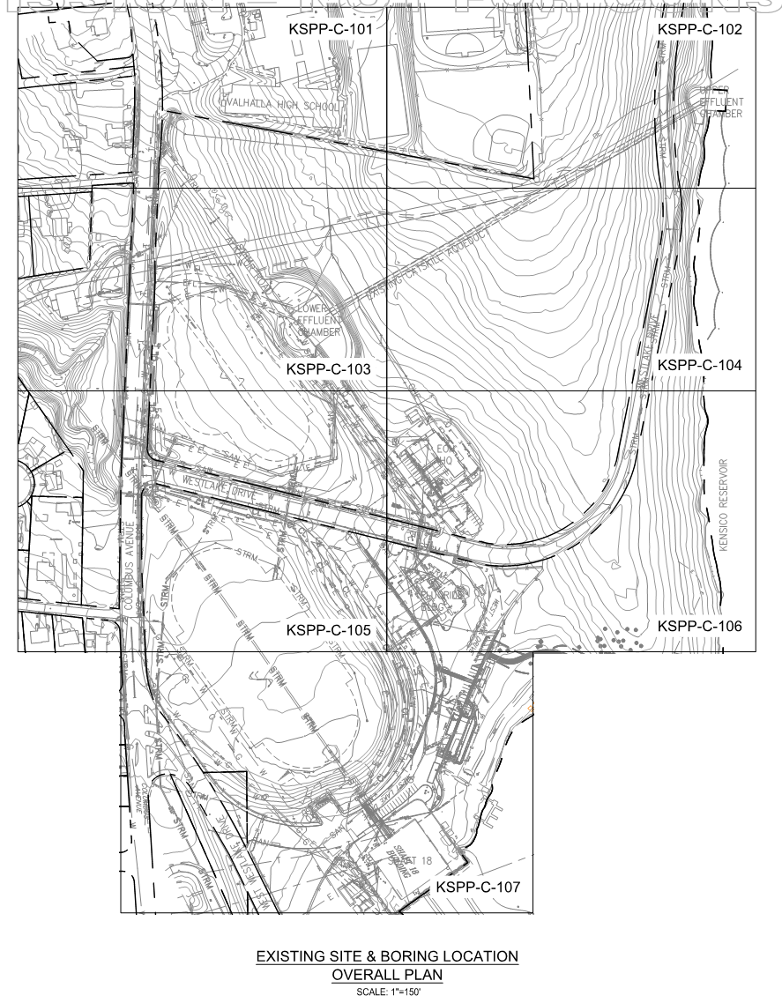
Project Overview: Site
Existing Site Plan

Slide 22
Project Drivers
The Delaware Aqueduct is currently the only means of water conveyance between Kensico Reservoir and the Catskill-Delaware Ultraviolet Disinfection Facility (CDUV) at Eastview.
Depending solely on the Delaware Aqueduct to supply water to the CDUV Facility reduces operational flexibility and system redundancy and increases the vulnerability for disruptions to water delivery.
The Kensico Eastview Connection (KEC) Project will provide a second means of conveying water from the Kensico Reservoir to the CDUV Facility in Eastview.
KENS-EAST-2 will be the first of three major contracts for KEC and is critical in ensuring certain components are in place for the KEC Project to progress. KENS-EAST-1 and KENS-EAST-3 will follow.
BODR Workshop

Slide 23

Construction Packaging
KENS-EAST-1 – Shaft 2C, KEC Tunnel, Shaft 1C, Shaft 1C Connection Tunnel, ECC SOE & SC SOE
KENS-EAST-2 – Kensico Site Prep
KENS-EAST-3 – UEC, SC, ECC, UEC Shaft & Connection Tunnels
KEC-SS – Shoreline Stabilization
KEC-WM – Wetland Mitigation
Other Contracts:
CRO-624 – Kensico Lab
CRO-557 – Waterfowl Building
Eastview Site Prep
Eastview Final Landscaping
Kensico Final Site
UEC Shaft
ECC
Kensico Site Prep
SC
UEC
Connection to CDUV
KENS-EAST-1
Kensico Reservoir
Eastview Connection Chamber Support of Excavation (ECC SOE)
Shaft 2C
Shaft 1C
KENS-EAST-2
Shaft 1C Connection Tunnel
Connection Tunnels
KEC Tunnel
KENS-EAST-3
Screen Chamber
Support of Excavation
(SC SOE)

Slide 24
Scope of Work
KENS-EAST-2: Kensico Site Preparation

Slide 25

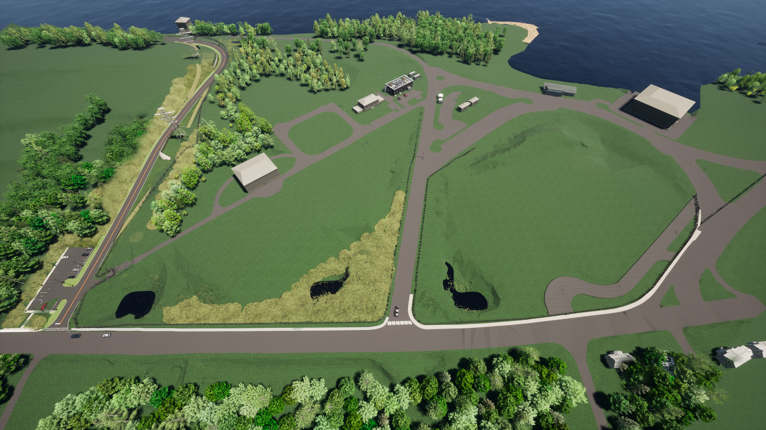
Scope of Work Overview
KENS-EAST-2 includes:
UEC
Bioretention Basin
New Electrical Building
Kensico Reservoir
Valhalla High School
New electrical Enclosure
Relocation of Westlake Drive
Grading and drainage for Screen Chamber Building and Tunnel Shaft Staging Area
EOH HQ
Shaft 18
LEC
Grading and drainage for Delaware Aerator staging area
Grading and drainage for Catskill Aerator staging area
Construction of Parking Lot
W. Westlake Drive
New Operations Entrance
Aerator Road
Westlake Drive
New Sediment Basin
New Sediment Basin
Relocated Westlake Drive
New Sediment Basin
Landscaping for non-staging areas
Columbus Avenue

Slide 26
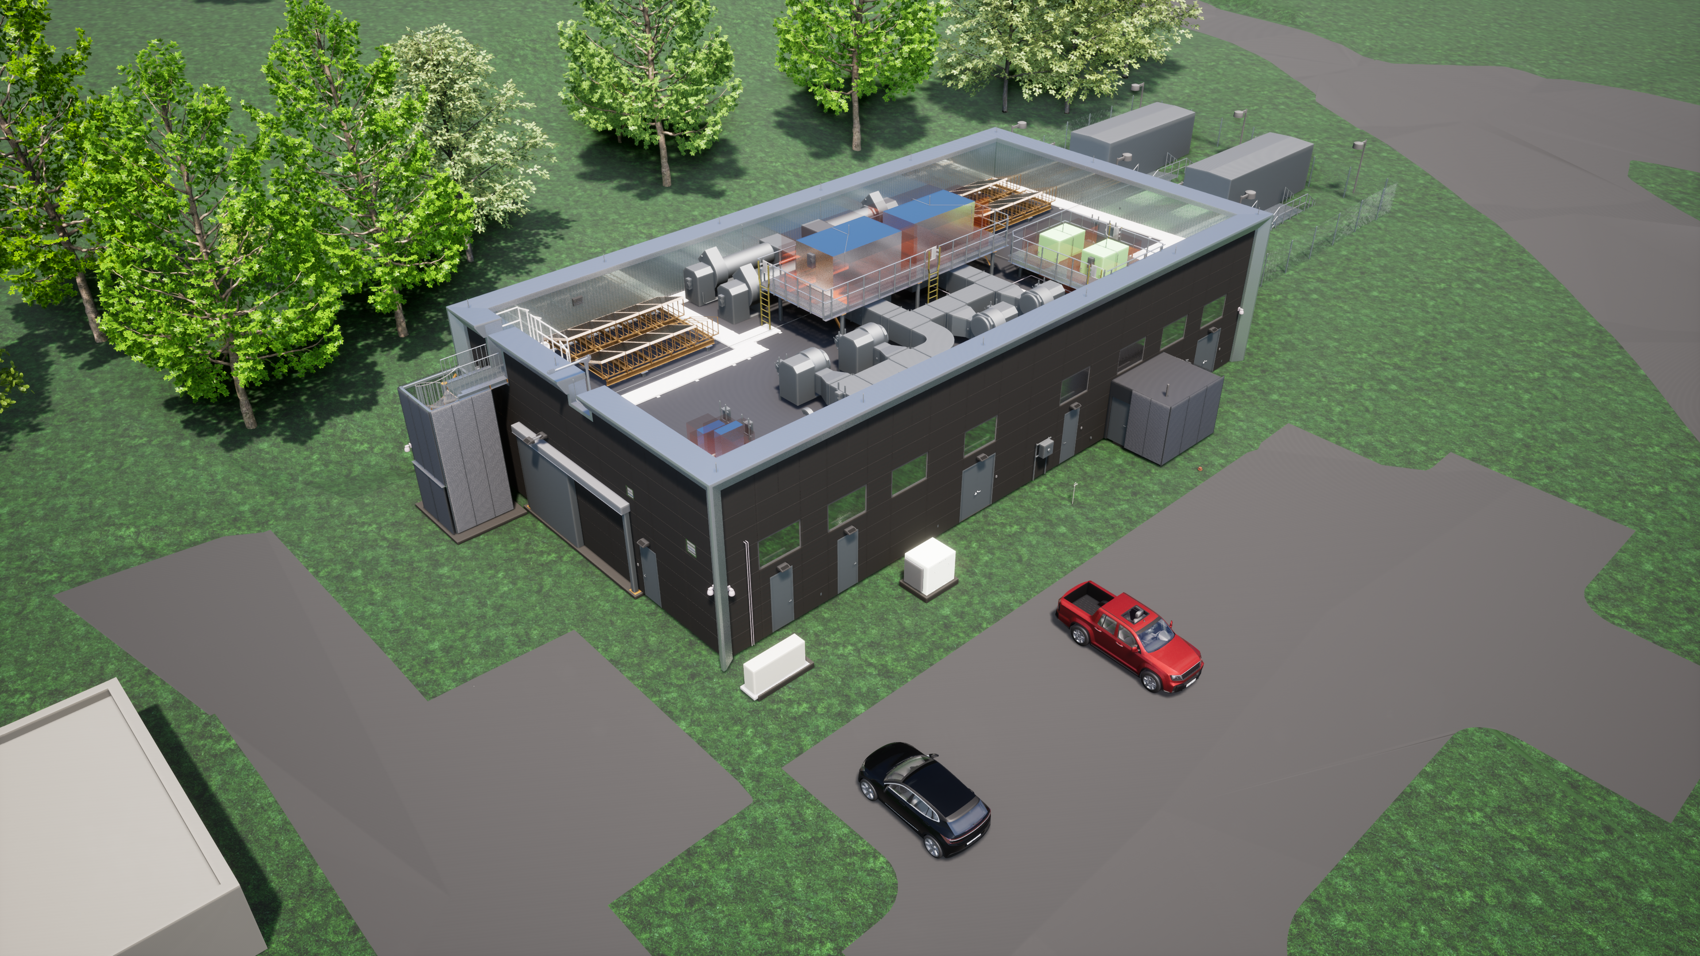
Electrical Building

Slide 27
Major Work Items
Overall site preparation and development
  Excavation and grading of the site
  Installation of perimeter construction and security fencing
  Installation of a temporary operations entrance
  Installation of site utilities
Relocation of Westlake Drive to the northern end of City property
  Construction of parking lot for Valhalla High School
Construction and installation of a new electrical building
  Unit substations and service entrance switchgears for new medium voltage electrical service and distribution
  Backup 800kW generators
  New electrical service feeds from ConEd
Refer to Specification 01 11 00: “Summary of Work” and the Contract Drawings for more detailed information.

Slide 28
Site Specific Items
Site Security:
Security guard services to be provided 24/7 until project closeout
Must meet qualifications and training requirements as detailed in Spec 01 35 55: Site Security Procedures
New guard booth to be provided by the contractor and will be located inside the new gated perimeter for Relocated Westlake Drive construction
Site Access:
Temporary access forms or security clearances must be obtained for access to the site by any contractor personnel
Contractor is required to maintain DEP access to existing facilities at the site throughout the duration of the contract
ConEd transmission tower access to be available throughout the duration of the contract

Slide 29
Project Coordination
Relocated Westlake Drive:
Relocated Westlake Drive must be near completion to be able to transition to existing Westlake Drive for partial construction access
Approval from DEP must be obtained after the Temporary Operations Entrance is fully tested and functional for complete transition to existing Westlake Drive for construction access to the site
Refurbished guard booth will be installed at existing Westlake Drive after the contractor transitions to existing Westlake Drive for construction access to the site
Electrical Building:
Coordinate necessary shutdowns with DEP to transfer existing facilities to new permanent power
Coordinate with ConEd on the approval and start-up of submitted electrical service equipment to ensure compliance with the latest codes and standards
Refer to Specifications 01 73 12: “Maintenance of Operations & Construction Staging” & 26 05 11: “General Electrical Requirements” for more detailed information

Slide 30
Work Restrictions
Working Hours
  Monday to Friday from 7:00AM to 3:30PM, except for Holidays
  Written approval from the Engineer is required for working other than normal project working hours
Strict compliance with Town of Mount Pleasant Noise Control Law
Compliance with Local Law 77 and reporting for non-road vehicles
  Refer to Local Law 77 DEP Monthly Reporting Forms to report usage on Ultra Low Sulfur Diesel fuel and Best Available Technology in diesel powered non-road vehicles for reducing emission of pollutants on a monthly basis
Tree Clearing
  Only allowed from November 1st to March 31st due to the project area being within the summer range for the Northern Long Eared and Indiana Bats
Erosion & Sediment Control (SWPPP)
  Active soil disturbances cannot exceed 5 acres
  Must be coordinated with other contractors at the site
Refer to Specification 01 14 00: “Work Restrictions” for more information.

Slide 31
Schedule
Procurement Milestones | Dates
Site Tour | July 12th, 2023 at 2PM
Pre-Bid Questions | July 26th, 2023
Bids Due | August 24th, 2023 at 10AM
Bid Opening | August 24th, 2023 at 2PM
Anticipated NTP | January 2024

Slide 32
Schedule
Project Milestones | Completion Date
Substantial Completion | 940 Days after NTP
Milestone #1: Complete all work for Relocated Westlake Drive and open it to public traffic | 700 Days after NTP
Milestone #2: Complete all Screen Chamber overburden work | 861 Days after NTP
Milestone #3: Complete all Electrical Building work and complete conduits and manhole in preparation for KENS-EAST-1 connection | 867 Days after NTP
Refer to Specification 01 27 10: “Project Milestones & Scheduling Constraints” for more information.

Slide 33
Regulatory Requirements
Key NYCDEP Obtained Permits/Approvals:
NYCDEP – City Environmental Quality Review (CEQR)
NYSDEC –State Pollutant Discharge Elimination System General Permit for Stormwater Discharges – Associated with Construction Activity (GP-0-20-001)
NYCDEP – Stormwater Pollution Prevention Plan Approval
NYCDEP – Environmental Impact Statement (EIS)
NYSDEC – Eagle Incidental Take Permit
NYCPDC – Design Approval
TMP – Municipal Separate Storm Sewer System (MS4) Approval
TMP – Site Plan Approval
Key Contractor Obtained Permits:
TMP – Street Opening/Curb Cut Permit
Westchester County – Road Access/Opening Permit
TMP – Building Permit
TMP – Plumbing Permit
TMP – Electrical Permit
Refer to Specification 01 41 00: “Regulatory Requirements” for more information.

Slide 34
Addendum #1
Key Changes:
Bid Booklet
  Latest NY State Revolving Fund Program Requirements Bid Packet
Contract Drawings
  Revisions and additions to the Drawing Index, civil drawings, and electrical drawings
Contract Specifications
  Revisions and edits to specifications from Divisions 1, 2, 5, 8, 23 ,32, and 40
  Revised Exhibit C for Specification 01 14 00: “Work Restrictions”
  Added language and requirements for the Refurbished Ballistic Rated Guard Booth to Specification 01 52 50: “Temporary Guard Booths”
    Changed language for guard booth ownership at the completion of work from contractor owned to NYCDEP
Bid Room Reference Documents
  ESA Phase II Report

Slide 35
EHS Requirements
KENS-EAST-2: Kensico Site Preparation

Slide 36
BEDC EHS Points of Contact
  BEDC EHS Personnel Contacts for this Project
    BEDC EHS Director – Neil Feldscher, CIH, CSP, Esq., FAIHA
    BEDC EHS Chief of Program Management– Chris Bucci
    BEDC EHS Chief of Field Management – Edgar Lopez, MA, CSP, ARM
    BEDC EHS Regional Manager
      Anne Ruzek
      (347)881-6564
      aruzek@dep.nyc.gov

Slide 37
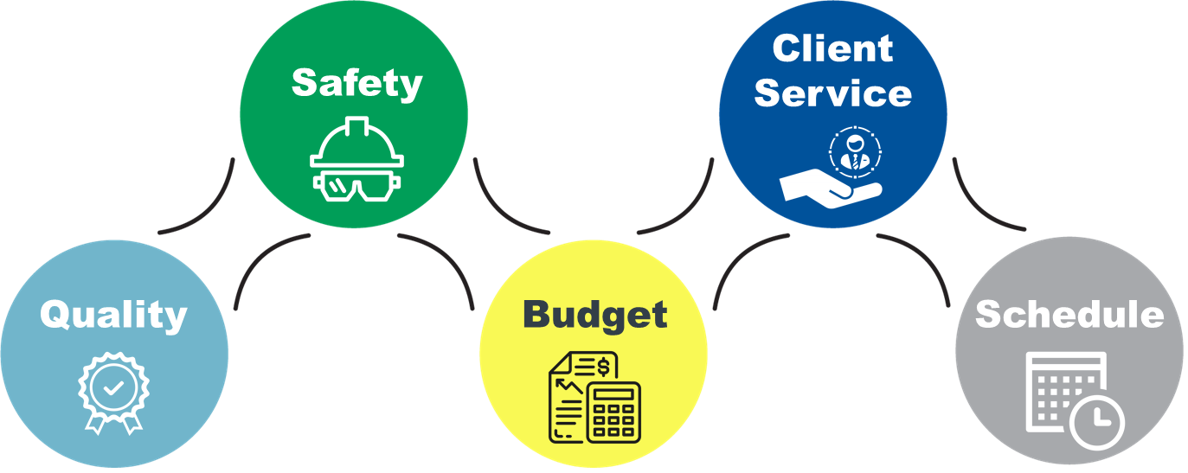
BEDC’s Mission & Core Values
BEDC’s MISSION
To run the safest most environmentally compliant capital construction program in the United States. No accidents, no harm to people, and no harm to the environment.
BEDC CORE VALUES

Slide 38
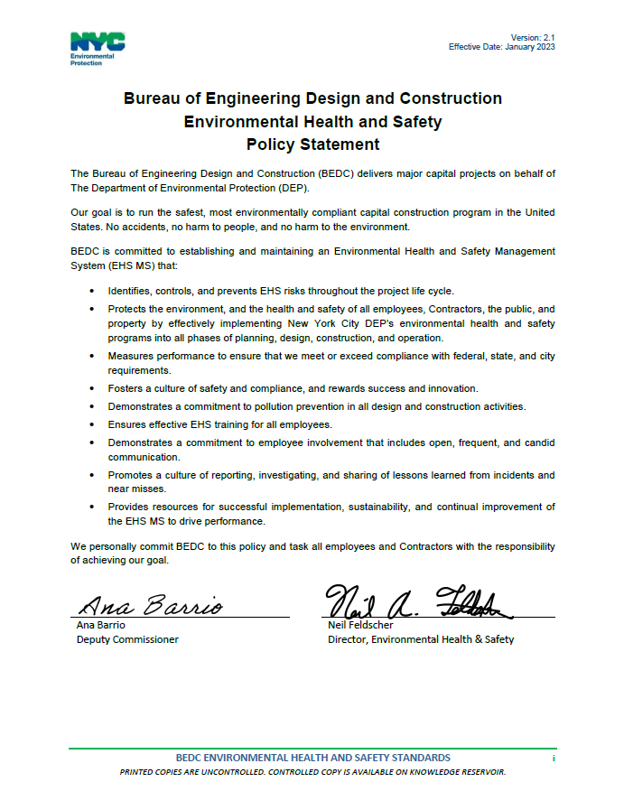
BEDC EHS Policy Statement

Slide 39
Highlights of EHS Top Requirements
Must know and comply with BEDC EHS Standards and applicable DEP EHS Policies and Procedures in addition to all City, State and Federal laws, rules and regulations (found on e-Builder Knowledge Reservoir)
Must attend Orientation and BEDC EHS Standards training
Submit Safety Professional, Environmental Professional & one or more (if >100 workers) full time EHS Representative
Submit Environmental, Health and Safety Plan (EHASP)
Submit COVID-19 Plan
Pre-Construction EHS Meeting
Legacy – Hazardous Material Assessment (Asbestos, Lead, PCBs, Mercury)
EHS Specifications - Contractors MUST READ

Slide 40
Additional EHS Requirements
Obtain and comply with environmental permits including air, water, wastewater and wetland
Required Hazardous Waste Documentation and Annual Reporting
Spill Prevention and Preparedness Program
Chemical Inventory Tracking and EPCRA Reporting
Develop and Implement Emergency Action Plans/Fire Protection Plans
Adhere to Local Law 77
Clear communication with all stakeholders throughout the life of the project
SMOKING IS NOT PERMITTED ON ANY CONSTRUCTION SITES
Notes:
Note to Preparer - Add the following bullets to meet project requirements and copy into slide above:
Operability Assessment Program- Completed for each work area prior to any electrical work being performed
Petroleum/Chemical Bulk Storage – comply with new NYSDEC regulations
Appropriate handling of waste streams – RCRA/DOT trained employees
NYC – Comply with NYCDOB Building Code

Slide 41
Contractor Selection and Management Policy
Pre-Award
Pre-Award EHS Program and Performance Review Submittal
  Provided to low bidder, Contractor must complete in 5 days)
Low bidder must demonstrate knowledge of and commitment to EHS
Have a proactive Corporate EHS program
An EMR above 1.0 requires additional submissions (see attachment A in 01 35 27)
Review, OSHA violations, spills, NOVs, incidents, past DEP EHS evaluations
Legacy Information
  DEP will provide information on all EHS Legacy issues and hazardous materials at the site. Contractor must inform employees.
Contractor Access Control Procedure
  Must maintain a Daily Contractor/Visitor Log
  Must obtain security clearance; maintain and carry an approved photo ID at all times while working
Contractor Incident and Violation Reporting
  Notify BEDC EHS immediately of any regulatory inspections, Notices of Citations and penalties, Notices of Violation (NOVs), Notices of Deficiencies (NODs) or any other outside agency violations

Slide 42
Contractor Selection and Management Policy
DEP Policy and Procedure for Pre-Award EHS Submittals (must submit within five (5) business days of request):
Attachment A of 01 35 27– Standard Environmental, Health & Safety Specifications
  EMR for the past three (3) years – on insurance broker letterhead
  OSHA 300 Forms for past three (3) years
  List of all NOVs received by a regulatory agency in the last three (3) years
  List of all reportable releases of chemical or petroleum products in the last three (3) years
  Written description of the company's EHS and training programs
  Certification from the company that its EHS and training programs meet all OSHA, USEPA, NYS, local regulations, and will abide by all applicable NYC DEP policies and procedures
Attachment B of 01 35 27– Bidder’s EHS Performance and Program Review Questionnaire
  Must be completed and submitted for evaluation to determine the adequacy of a bidder’s EHS program

Slide 43
Contractor Selection and Management Policy
Additional Requirements of the Contractor Selection and Management Policy:
Attachment C - Contractor Orientation Checklist (Contractor must complete this form)
Attachment D - Contractor Orientation Training Certification
  All Contractor employees must sign this form
  Contractor must complete form certifying they trained workers
Attachment E - Contractor EHS Evaluation Form
  Contractor and EHS Representative to be evaluated every six (6) months

Slide 44
Contractor Selection and Management Policy
To be responsive to the requirements of the Specifications, bidder’s EHS and training program descriptions, as contained in the submittal, must indicate that:
The bidder understands its regulatory requirements,
Has adequate EHS and training programs in place,
Has an EMR that is at 1.0 or below or (if has no EMR) a comparable record, based on the information provided,
Has adequate, qualified, EHS professionals available for the project,
Has demonstrated an acceptable EHS record on similar projects over the past 3 years, and;
Certified its programs and training comply with all regulatory requirements.

Slide 45
EHS Specifications
Contractors MUST READ all Specifications including the following which have specific EHS requirements:
01 35 27 Environmental Health and Safety Requirements
01 74 17 Cleaning and Site Maintenance
01 35 44 Working in Hazardous (Classified) Locations
01 35 45 Hazardous Materials Control
01 57 16 Temporary Pest Control
01 74 20 Construction Waste Management
01 41 00 Regulatory Requirements
Notes:
Note to Preparer - Modify this list to meet project requirements and add additional detail as needed.

Slide 46
EHS Specifications
Contractors MUST READ all Specifications including the following which have specific EHS requirements:
02 24 20 Soil Sampling and Analysis (requires QEP/ Field Sampling Summary Report before excavation)
02 41 10 Demolition and Removals
02 43 10 Relocation of Utilities
02 82 05 Asbestos Management
02 83 05 Lead Management
02 84 05 PCB Management
02 84 10 Mercury Management
Notes:
Note to Preparer - Modify this list to meet project requirements and add additional detail as needed

Slide 47
EHS Specifications
Contractors MUST READ all Specifications including the following which have specific EHS requirements:
  31 23 16 Excavation
  31 23 19 Dewatering
  31 25 10 Dust, Soil Erosion and Sediment Control
Notes:
Note to Preparer - Modify this list to meet project requirements and add additional detail as needed

Slide 48
01 35 27 EHS Specification Requirements
    Must know and comply with all:
  BEDC EHS Standards Manual
  DEP EHS Policies & Procedures
  Federal, State, and Local EHS laws, rules, and regulations
Attend 4-Hour EHS Standards Training for:
  Project Manager
  Site Supervisor
  Safety Professional (SP)
  Environmental Professional (EP)
  Electrical Safety Professional (ESP)
  EHS Representative (EHSR)
  Electrical Safety Worker (ESW)
Notes:
Note to Preparer - Review the project version of Section 01 35 27 to determine which Contractor EHS Personnel to include in this presentation.

Slide 49
01 35 27 EHS Specification Requirements
Submit EHS Professionals
Safety Professional, Environmental Professional and Electrical Safety Professional
May be the same person if they meet the qualifications
Submit EHS Representative and alternate(s)
Shall have no other duties except those related to EHS
Submit all employee/subcontractor training records
All workers must have current OSHA-10 Hour or OSHA 30-hour training (within 5 years)
Project specific training – will depend on hazards on-site
Submit EHS Plans
Environmental Health & Safety Plans (EHASP), Emergency Action Plan (EAP) and Spill Prevention Program (SPP), COVID-19 Plan
Within 30 business days of Notice to Proceed (NTP)
Notes:
Note to Preparer - Modify this list to meet project requirements and add additional detail as needed. Add the following bullets to meet project requirements if needed:
Submit Confined Space Entry Program
Submit EMTs (Emergency Medical Technician) and Rescue Teams
Submit Lockout/Tagout (LOTO) / Energy Control Plan (ECP)
Submit Electrical Safety Worker
Submit Qualified Environmental Professional (QEP) as per Section 02 24 20 – Soil Sampling and Analysis

Slide 50
01 35 27 EHS Specification Requirements
    Submit Risk Control Reports
    Within one day of receipt from insurance carrier
Submit monthly Contractor EHS Report
    On or before the 10th day of each month
Adhere to the BEDC Incident and Near Miss Reporting and Investigation Standard
Report Regulatory violations including Notices of Violations (NOV)
    Notify BEDC EHS immediately of any regulatory inspections, Notices of Citations and penalties, Notices of Violation (NOVs), Notices of Deficiencies (NODs) or any other outside agency violations.
    Furnish a copy of all related correspondence within one day of receipt.
Notes:
Note to Preparer - Modify this list to meet project requirements and add additional detail as needed. Add the following bullets to meet project requirements if needed:
Submit Confined Space Entry Program
Submit EMTs (Emergency Medical Technician) and Rescue Teams
Submit Lockout/Tagout (LOTO) / Energy Control Plan (ECP)
Submit Electrical Safety Worker

Slide 51

BEDC Enterprise PMIS
    Web-Based Project Management Information System (Specification 01 31 25)
    The Contractor shall utilize the DEP’s web-based PMIS for electronic submittal of all data and documents throughout the duration of the Contract.
    The System will operate primarily on an e-Builder, Inc. (www.e-builder.net) platform that will be administered by DEP and the CM. The joint use of this System will facilitate electronic exchange of information, automation of key processes, and overall management of the Contract.
    Example processes:
  Subcontractor Approvals
  Submittals
  RFI’s
  Permits
Notes:
Note to Preparer - Modify this list to meet project requirements and add additional detail as needed. Add the following bullets to meet project requirements if needed:
Submit Confined Space Entry Program
Submit EMTs (Emergency Medical Technician) and Rescue Teams
Submit Lockout/Tagout (LOTO) / Energy Control Plan (ECP)
Submit Electrical Safety Worker

Slide 52

Questions
Thank You

Slide 53
Scan the QR Code
After Scanning, Enter all requested information, the completed list will be posted in PASSPort
Contract Number: KENS-EAST-2

